Slide 1
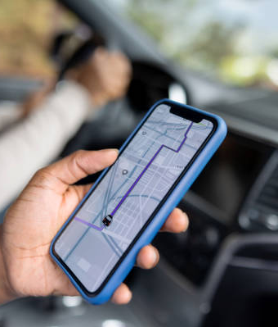

Design Thinking Model-
Presentation by:
Siddhant Saxena
2025B01010054
CSE-27

Slide 2


What is UBER?
UberCab, founded in 2009, operates in 70 countries, 10,000+ cities
Ride-hailing platform, connects passenger and driver
Allows to book rides, track drivers, cashless payments, rating feedbacks
Entering in multiple services UberX, UberPool, UberAuto, and UberEats, and more
Advancing in EVs, autonomous driving, sustainable transportation solutions

Slide 3



Expansion of UBER
UberAuto
UberPool
UberEats
A service that connects riders with auto-rickshaws in cities
A ride-sharing option, you share a ride with other passengers going in the same direction to lower the charges
Online food delivery service that connects customers to local restaurants

Slide 4

5 Stages of Design Thinking Model
Empathize
Define
Ideate
Prototype
Testing

Slide 5
5 Stages of Design Thinking Model
Empathize
Define
Ideate
Prototype
Testing

Slide 6
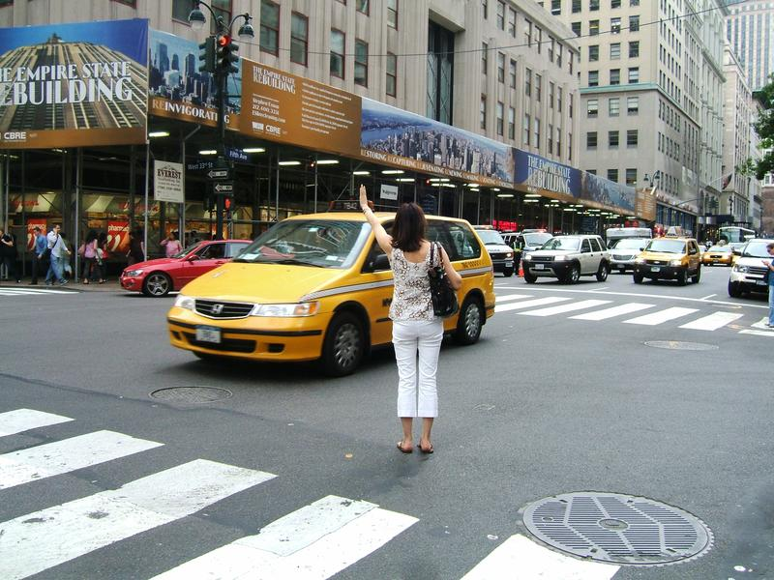
Empathize
Riders: quick, reliable, affordable transportation
Drivers: flexible earning opportunities
Difficult to find taxi in rush hours
Taxi prices were unpredictable
Drivers struggles to find consistent passengers and had to wait idle
Empathy Tools:
User interviews: Talking to commuters frustrated by high rates/unavailability.
Surveys: Gathering data on wait times, and cost expectations.
Observation: Watching how users book taxis, deal with cash payments, and wait times.

Slide 7
5 Stages of Design Thinking Model
Empathize
Define
Ideate
Prototype
Testing

Slide 8
5 Stages of Design Thinking Model
Empathize
Define
Ideate
Prototype
Testing

Slide 9

Define
Problem Statement:-
"How can passengers have a reliable way to book rides and how can drivers have a more flexible way of earning money?"

Slide 10
5 Stages of Design Thinking Model
Empathize
Define
Ideate
Prototype
Testing

Slide 11
5 Stages of Design Thinking Model
Empathize
Define
Ideate
Prototype
Testing

Slide 12
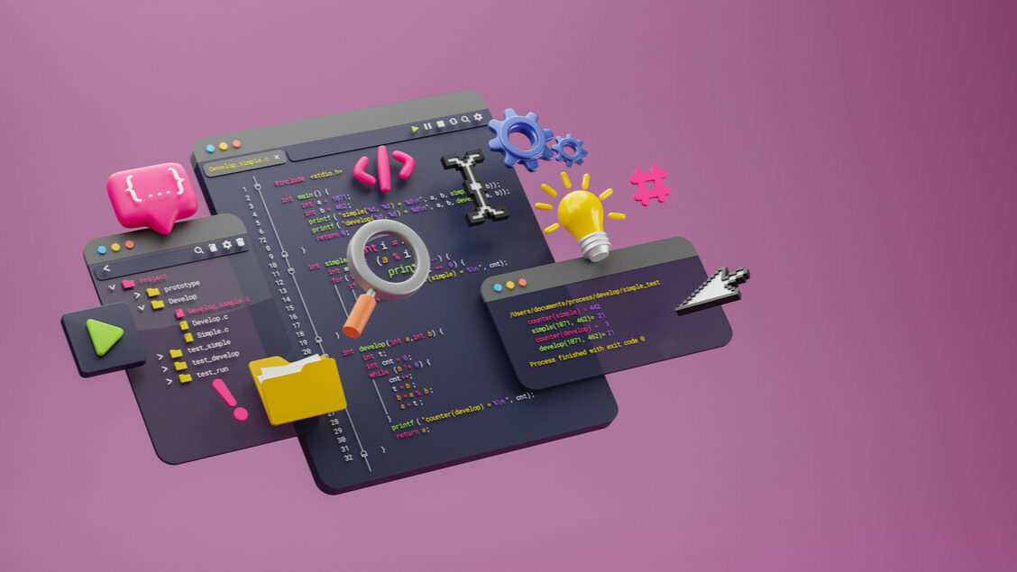
Ideate
Digital platform that connects riders and drivers in real time, with pricing transparency and cashless transactions for ease
Core need -
GPS based tracking
Dynamic pricing
Rating and feedback system
Ride sharing

Slide 13
5 Stages of Design Thinking Model
Empathize
Define
Ideate
Prototype
Testing

Slide 14
5 Stages of Design Thinking Model
Empathize
Define
Ideate
Prototype
Testing

Slide 15

Prototype
A mobile app interface for both riders and drivers
UberCab:
Features:
'Request a Ride' button
Real time Map View
Driver details and ETA
In-app payment option
Ride history and ratings

Slide 16
5 Stages of Design Thinking Model
Empathize
Define
Ideate
Prototype
Testing

Slide 17
5 Stages of Design Thinking Model
Empathize
Define
Ideate
Prototype
Testing

Slide 18
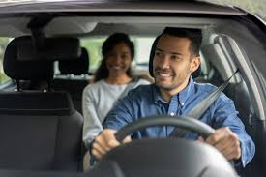
Testing
App launched to a small group of users in San Francisco
Collected user feedback, regarding ease of use, wait times, trust levels
Collected driver feedback, regarding navigating ease and earnings

Slide 19

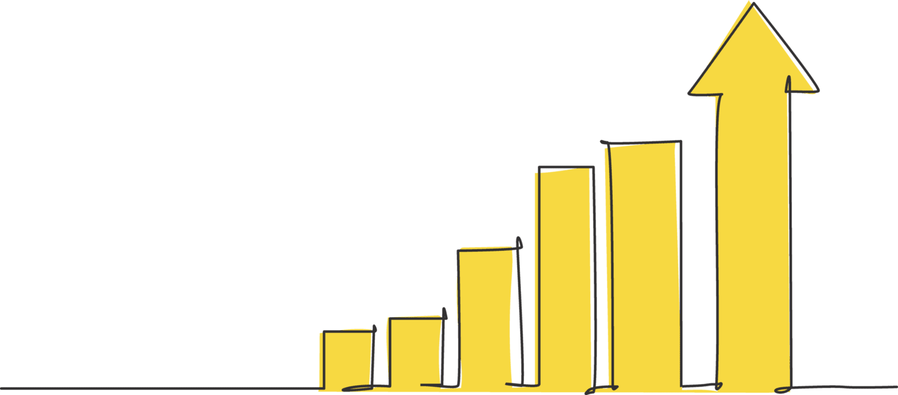
Outcomes
Users loved the convenience and predictability
Evolved into a global platform with services like UberPool, UberEats, and UberMoto.
Continuous testing and refinements, new features, and local customizations.

Slide 20
Conclusion
UBER wanted to solve the problem of high charges and taxi waiting periods for customers in rush hours
Wanted to make more flexible source of income for drivers and also reduce their idle time
Made an app for digital booking of cabs for the ease of both
Included cashless payments, GPS tracking of the ride, live location of driver, ETA, rating feedback system
Launched the app within a small group of individuals
Became so popular, got released on global level
Now active in 70 countries and 10,000+ cities
Expanded to UberMoto, UberAuto, UberPool, UberEats, EVs, autonomous driving.

Slide 21

Thank you
Design Thinking
5 Stage Model
UBER
Created and Presented by:
Siddhant Saxena
CSE-27
2025B01010054

